Slide 1
Unit 1

Slide 2
Introduction to Cyber Security
Internet Governance – Challenges and Constraints
Cyber Threats:- Cyber Warfare-Cyber Crime-Cyber terrorism-Cyber Espionage
Need for a Nodal Authority
Need for an International convention on Cyberspace.

Slide 3
Cyber Security Intro
Cyber security is combination of two words CYBER and SECURITY.
Cyber means information that is in digital form on Internet and publicly available.
Security means we have to provide protection to these data that is available on internet.
Definition of Cyber Security
Practice of protecting systems, networks, programs from Digital or Malicious Attacks.
These attacks are usually aim to accessing the information or destroying sensitive information.

Slide 4
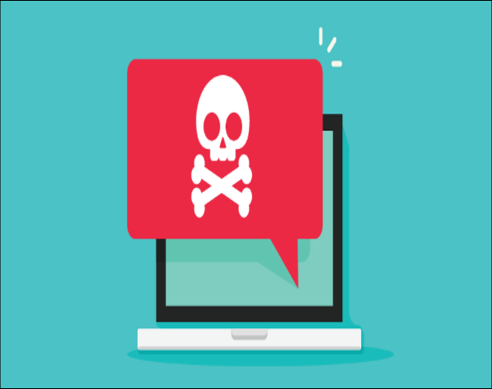
Virus
A computer virus is a program that can copy itself and infect a computer without the permission or knowledge of the user.
A computer virus has 2 major Characteristics:
The ability to replicate itself.
The ability to attach itself to another computer file.

Slide 5
Warning bells for Virus
Frequent pop-up windows.
Mass emails being sent from your email account.
Frequent crashes.
Unusually slow computer performance.
Unknown programs that start up when you turn on your computer.
Unusual activities like password changes.

Slide 6
Hacker and Hacking
HACKING is the gaining of access to a computer and viewing, copying or creating data without the intention of destroying data or maliciously harming the computer.
A hacker is a person skilled in information technology who uses their technical knowledge to achieve a goal or overcome an obstacle, within a computerized system by non-standard means.
Someone who utilizes their technical know-how of bugs or exploits to break into computer systems and access data which would otherwise be unavailable to them.

Slide 7
Types of Hackers
There are three types of hacker:
White hat hacker: It involves performing a security evaluation and testing with complete knowledge of the network infrastructure.
Gray hat Hacker: It involves performing a security evaluation and testing internally.
It examines the extent of access by insiders within the
network.
Black hat Hacker: Testing with no prior knowledge of the network infrastructure or systems.
It takes longest amount of time and most efforts.

Slide 8
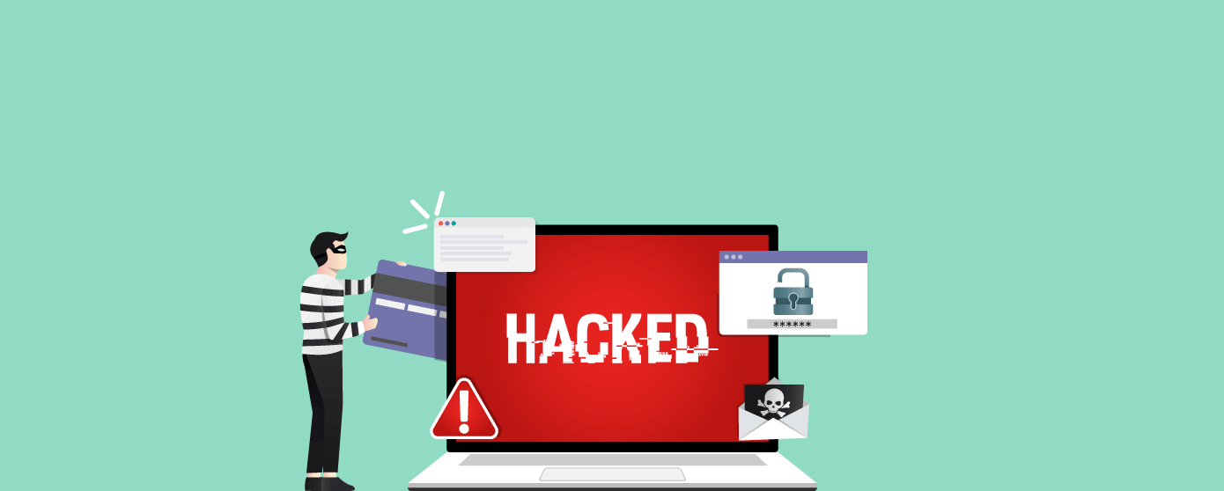
Types of Hacking
Website Hacking: Web hacking refers to exploitation of applications via HTTP which can be done by manipulating the application via its graphical web interface, tampering the Uniform Resource Identifier (URI) or tampering HTTP elements not contained in the URI.

Slide 9
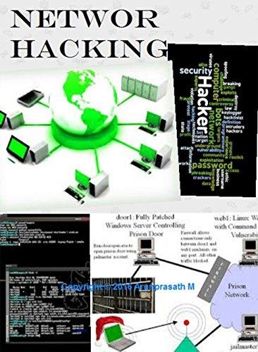
Network Hacking:
Network hacking generally means gathering information about domain by using tools like
Telnet,
netcat,
nslookup,
Ping,
Tracert.

Slide 10
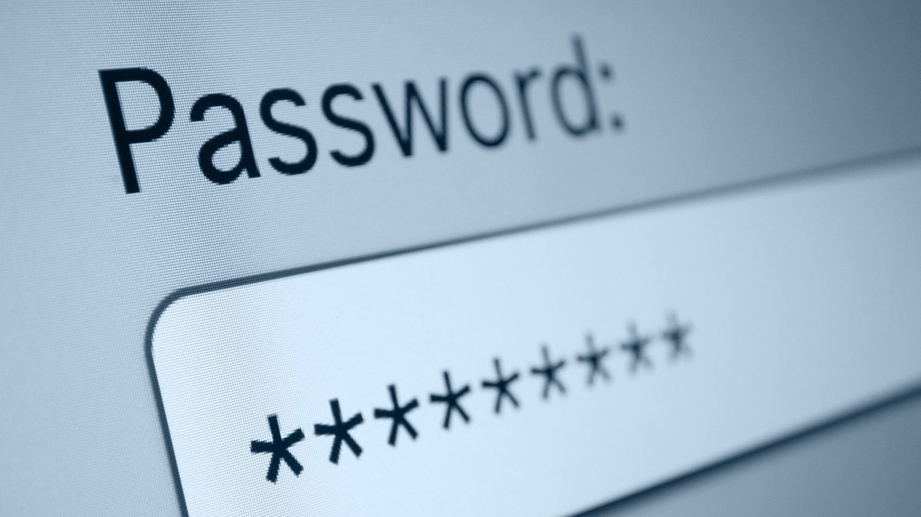
Password Hacking: Hackers will get your credentials through the key-logging.

Slide 11
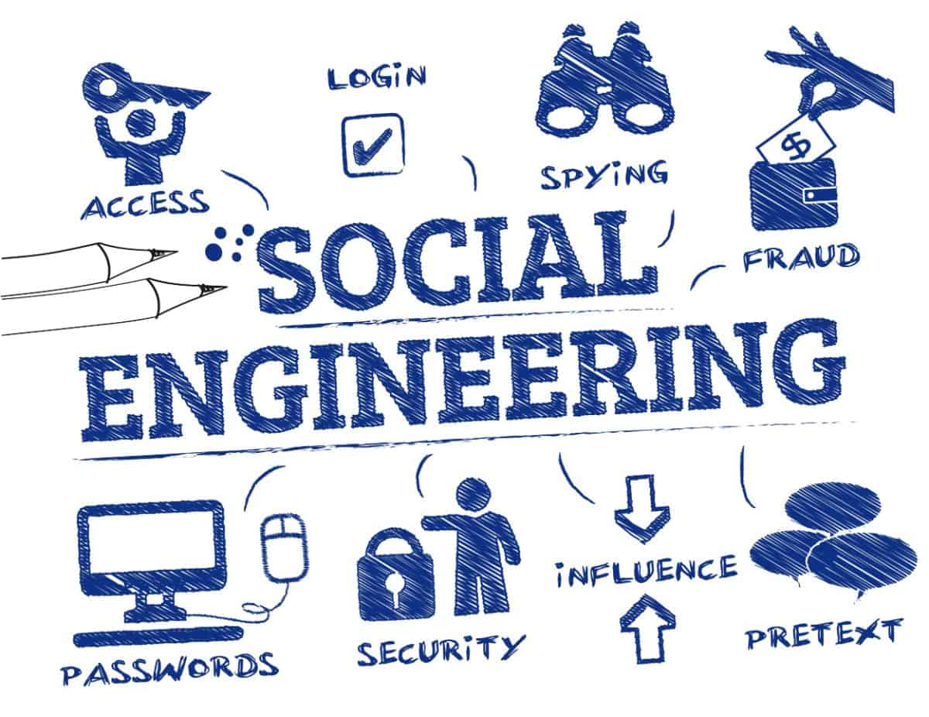
Social Engineering: Social engineering is an attempt to urge you to share personal info, sometimes by impersonating a trustworthy supply.

Slide 12
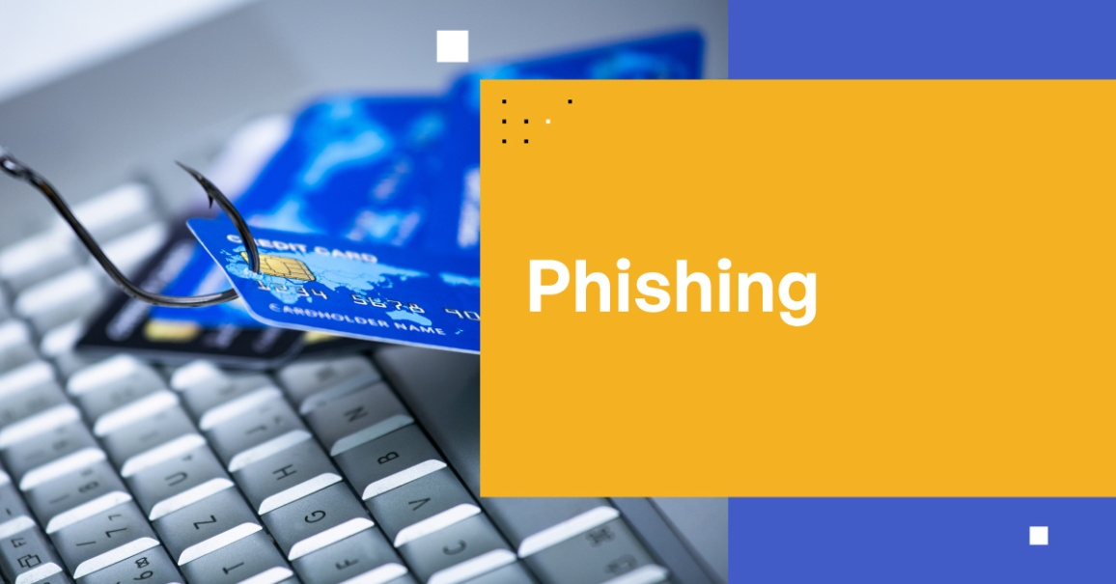
Phishing: In this type of hacking, hackers intention to stole critical information of users like account passwords, MasterCard detail, etc. For example, hackers can make a replicating first website for users interaction and can steal critical information.

Slide 13
Malware
Malware is intrusive software that is designed to damage and destroy computers and computer systems. Malware is a contraction for “malicious software.”
Mainly designed to transmit information about your web browsing habits to the third party.

Slide 14
Malware (Contd.)
Types:
Viruses
Trojan Horse
Spyware
Adware
Worms

Slide 15

INTERNET GOVERNANCE
WSIS (World Summit on the Information Society) Proposed the definition.

Slide 16
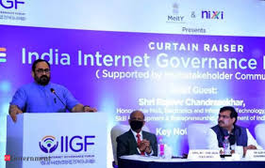
INTERNET GOVERNANCE
Internet governance is the development and application by
Governments,
the private sector and
civil society,
in their respective roles, of shared principles, norms, rules, decision-making procedures, and programs that shape the evolution and use of the Internet.
Notes:
Rajeev Chandrasekhar, Minister of State, Electronics & Information Technology.

Slide 17
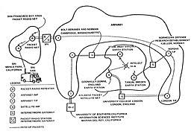
INTERNET GOVERNANCE
In other word Internet is decentralized network of computers. No one, company, government or organization runs the internet. And to run internet we have to set some rules.
ARPANET is one of the components which eventually evolved to become the Internet.

Slide 18
SELF REGULATION
Self regulation works in a group with strong community ties, by applying peer pressure or exclusion.
ISPs try to self regulate by imposing standards of behavior for their customers.
Self regulation doesn’t always work like IoT where thing are managed automatically.

Slide 19
Policy Making
Promote the open, distributed and interconnected nature of the Internet.
Ensure transparency, fair process, and accountability.

Slide 20
CHALLENGES AND CONSTRAINTS
Ransomware Evolution: Ransomware is a type of malware in which the data on a victim's computer is locked, and payment is demanded before the ransomed data is unlocked.
Blockchain Revolution: A blockchain is a database that stores data in the form of chained blocks.
IoT Threats: IoT stands for Internet of Things. It is a system of interrelated physical devices which can be accessible through the internet.

Slide 21
CHALLENGES AND CONSTRAINTS (Contd.)
AI Expansion: It is an area of computer science which is the creation of intelligent machines that do work and react like humans. Some of the activities related to artificial intelligence include speech recognition, Learning, Planning, Problem- solving, etc.
Serverless Apps Vulnerability: Serverless architecture and apps is an application which depends on third-party cloud infrastructure or on a back-end service such as google cloud function, Amazon web services (AWS) lambda, etc.

Slide 22
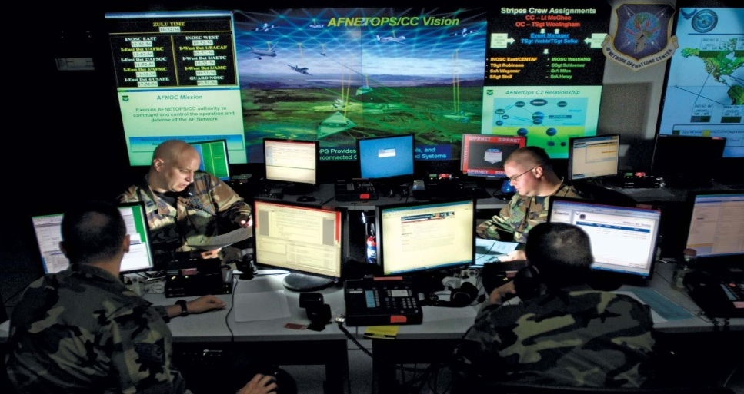
CYBER WARFARE
Cyber Warfare is Internet based conflict involving politically motivated attacks on information systems.
It also involves the action by a nation-state or International organization to attack and
attempt to damage another nation’s computers and information.

Slide 23
CYBER WARFARE Types
Espionage
Sabotage
DoS Attack
Electrical Power Grid
Propaganda Attacks
Economic Disruption
Sunrise Attack

Slide 24
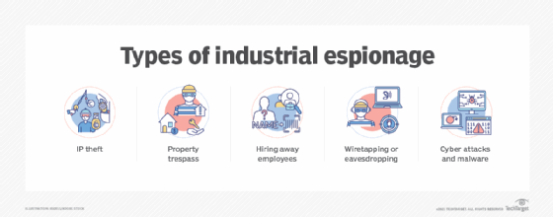
Espionage
Refers to monitoring other countries to steal secrets.

Slide 25
Sabotage
Government organizations must determine sensitive information and the risks if it is compromised.
Hostile governments or terrorists may steal information, destroy it, or leverage insider threats such as dissatisfied or careless employees, or government employees with affiliation to the attacking country.

Slide 26

Sabotage (Contd.)

Slide 27
Denial of Service (DoS)
DoS attacks prevent legitimate users from accessing a website by flooding it with fake requests and forcing the website to handle these requests.

Slide 28
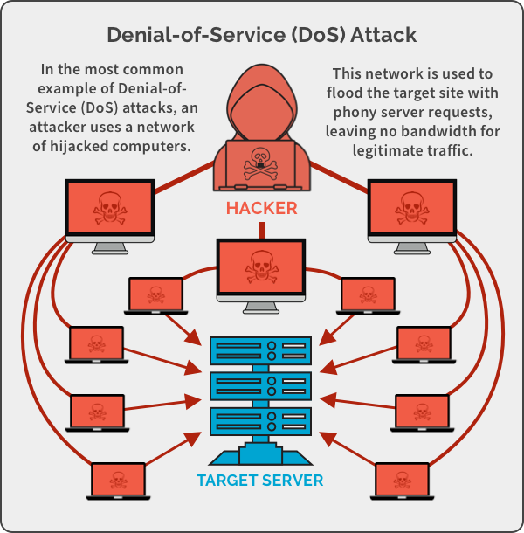

Slide 29
Electrical Power Grid
Attacking the power grid allows attackers to disable critical systems, disrupt infrastructure, and potentially result in bodily harm. Attacks on the power grid can also disrupt communications and render services such as text messages and communications unusable.

Slide 30
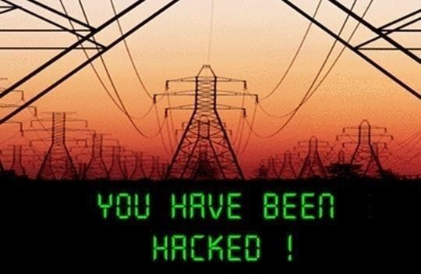
Electrical Power Grid (Contd.)

Slide 31
Propaganda Attacks
Attempts to control the minds and thoughts of people living in or fighting for a target country

Slide 32
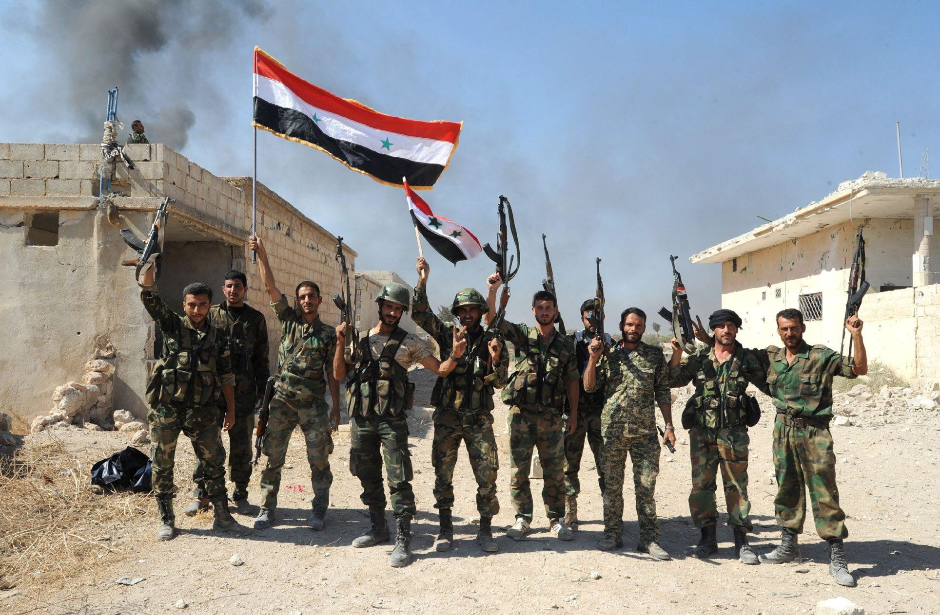
Propaganda Attacks (Contd.)

Slide 33
Economic Disruption
Most modern economic systems operate using computers.
Attackers can target computer networks of economic establishments such as stock markets, payment systems, and banks to steal money or block people from accessing the funds they need.

Slide 34
Sunrise Attacks
These are the cyber equivalent of attacks like Pearl Harbor and 9/11.
The point is to carry out a massive attack that the enemy isn’t expecting, enabling the attacker to weaken their defenses

Slide 35
Cybercrime
Cybercrime is a crime that involves a computer and a network.
The computer may have been used in the commission of a crime, or it may be the target. Cybercrime may harm someone's security and financial health.

Slide 36
Cyber Crime Case Studies
On 21 May 2021, it was reported that Air India was subjected to a cyberattack whereas the personal details of about 4.5 million customers around the world were compromised including passport, credit card details, birth dates, name and ticket information.

Slide 37
Cyber Crime Case Studies
It was reported that the compromised servers by the hackers were later secured and Air India took steps by engaging external data security specialists.
Air India also guaranteed its passengers that there was no conclusive evidence on whether any misuse of the personal data has been reported.
The airlines also urged and encouraged the passengers to immediately change their passwords.

Slide 38
Cyber Crime Case Studies
Vulnerabilities in the e-commerce domain of Indian bookseller Oswaal Books could have allowed attackers to seize control of the website, a security researcher has claimed.

Slide 39
Cyber Crime Case Studies
After taking control of the administrator account via SQL injection the researcher achieved remote code execution (RCE), bypassed one-time password (OTP) authentication, and unearthed a cross-site request forgery (CSRF) bug, he claims.

Slide 40
Cybercrimes Classification
Against Individual
EMAIL Spoofing: Email spoofing is a form of cyber attack in which a hacker sends an email that has been manipulated to seem as if it originated from a trusted source.
Phishing: Phishing is a cybercrime in which a target or targets are contacted by email, telephone or text message by someone posing as a legitimate institution to lure individuals into providing sensitive data such as personally identifiable information, banking and credit card details, and passwords.

Slide 41
Cybercrimes Classification (Contd.)
Against Individual
Spamming: Spamming is the use of messaging systems to send multiple unsolicited messages to large numbers of recipients for the purpose of commercial advertising, for the purpose of non-commercial proselytizing, for any prohibited purpose, or simply sending the same message over and over to the same user.
Password sniffing: Password sniffing is an attack on the Internet that is used to steal user names and passwords from the network. Man-in-the-middle attacks are commonly used for stealing passwords and credentials today.

Slide 42
Cybercrimes Classification (Contd.)
Against property:
– Credit card frauds: Credit card fraud is the unauthorized use of a credit or debit card, or similar payment tool (ACH, EFT, recurring charge, etc.), to fraudulently obtain money or property.

Slide 43
Cybercrimes Classification (Contd.)
Against property:
Intellectual property:
Patent infringement:
Trademark infringement:
Copyright infringement:
Internet time theft: It refers to the theft in a manner where the unauthorized person uses internet hours paid by another person.

Slide 44
Cybercrimes Classification (Contd.)
Against Organization:
Unauthorized accessing of computer
Virus Attacks
E-Mail bombing
Trojan Horse
Software piracy

Slide 45
Cybercrimes Classification (Contd.)
Against Society:
Forgery
Cyber Terrorism
Web Jacking

Slide 46
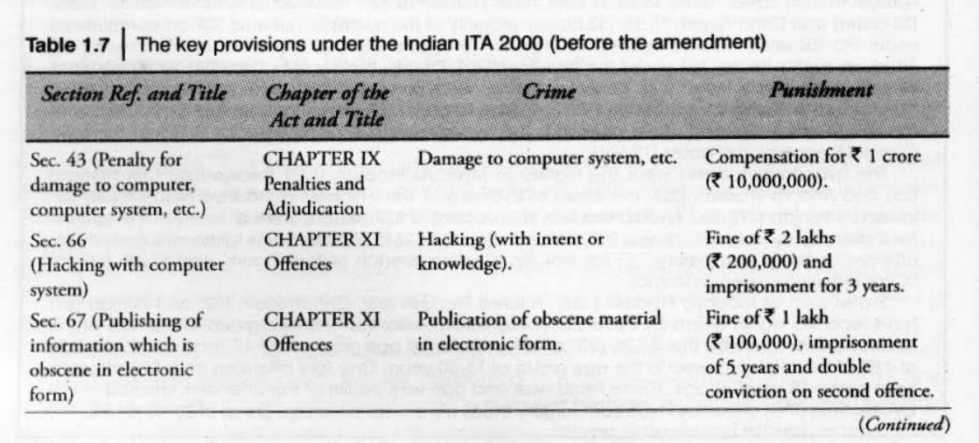
Indian ITA 2000

Slide 47
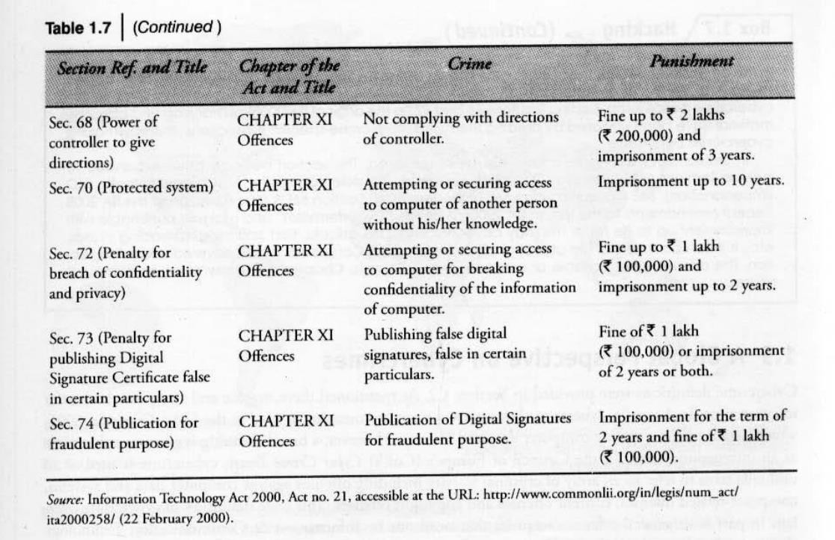
Indian ITA 2000 (Contd.)

Slide 48
CYBERTERRORISM
Cyberterrorism is the premeditated, politically motivated attack against information, computer systems. Computer programs and data which result in violence against noncombatant targets sub national groups.
Lack of information security gives rise to cybercrimes. INDIAN INFORAMATION TECHNOLOGY ACT ITA 2000 provides new focus on Information security in india.

Slide 49
Targets
Targets may include power plants, military installation, the banking industry, air traffic control centers.

Slide 50
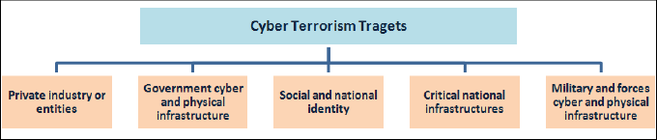
Targets (Contd.)

Slide 51
Cyber Terrorism Challenges
Difficulty Identifying Attackers: It remains difficult to determine the identity of the initiators of most cyber attacks.
Lack of boundaries: Attacks can originate from anywhere in the world and from multiple locations simultaneously.
Speed of development: The time between the discovery of a new vulnerability and the emergence of a new tool or technique that exploits the vulnerability is getting shorter.

Slide 52
Cyber Terrorism Challenges (Contd.)
Low cost tools: The technology employed in attacks is simple to use, inexpensive, and widely available.
Automated Methods: The methods of attack have become automated and more sophisticated, resulting in greater damage from a single attack.

Slide 53
Cyber Terrorism Forms
Privacy violation.
Secret information appropriation and data theft.
Demolition of e-governance base.
Distributed Denial Of Service (DoS) attack.
Network damage and disruptions.
Use of cyber communication for terrorism.

Slide 54
Attack Methods
Physical Attack:
Against computer facilities and/or transmission lines.
Accomplished by use of conventional weapons to destroy or seriously injure computer and their terminal.
Electronic Attack:
Use of power of electromagnetic energy or electromagnetic pulse to overload computer circuitry.
Cyber Attack:
Use of malicious code to take advantage of software’s weakness.

Slide 55
Cyber Terrorism Tools
Viruses: Malicious code that attaches to another file and can modify or delete data.
Worms: Self-replicating malware that can spread to other computers on a network.
Trojan horses: Malicious programs that appear to be normal programs but actually contain hidden programs.
Logic bombs: Code that is secretly inserted into a system and activates a malicious function when certain conditions are met.
Trap doors: Secret entry points to a system that are usually only known to the system's developer.
DoS attacks: Malicious attempts to cause a system to deny service to its users.
Cryptography:
Steganography:

Slide 56
Application vulnerabilities
Open Web Application Security Project (OWASP) online community created the OWASP Top Ten
Analyze the data obtained through web application assessments that followed the black, gray and white box approaches.
Black, gray and white box methods implied different levels of access to the applications (source code)
Almost every application assessed with gray box was analyzed with black box too,
Combined these two approaches 83% of the web application projects attacked by the black and gray box methods.

Slide 57
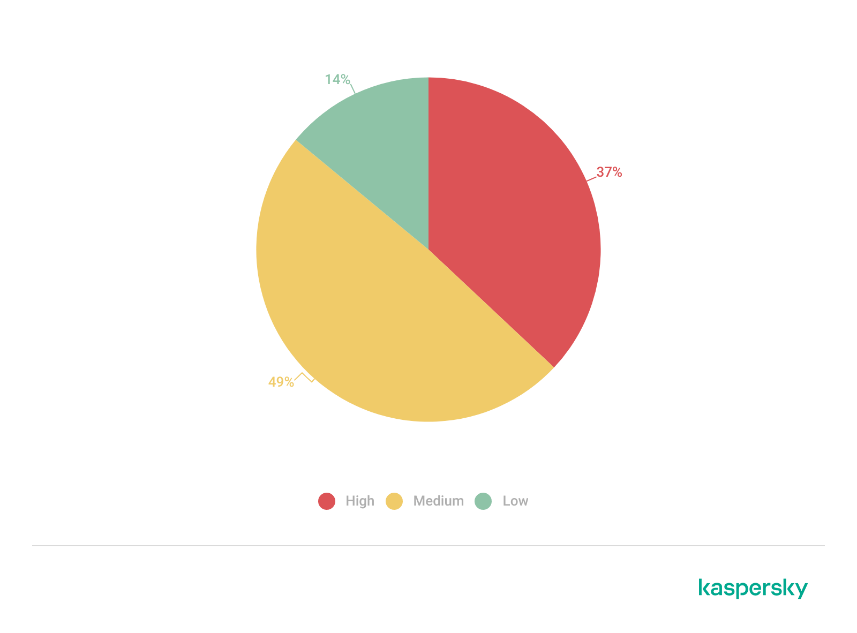
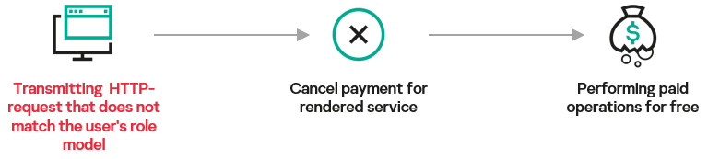
Broken Access Control
70% of the web applications we analyzed contained vulnerabilities associated with access control issues.
In one application, inadequate validation of data being submitted let us reach internal services and potentially execute attacks leading to financial loss.
Mitigation: Role-based access model: Unless the resource is intended to be publicly accessible, deny access by default
Distribution of Broken Access Control vulnerabilities by risk level, 2021–2023

Slide 58
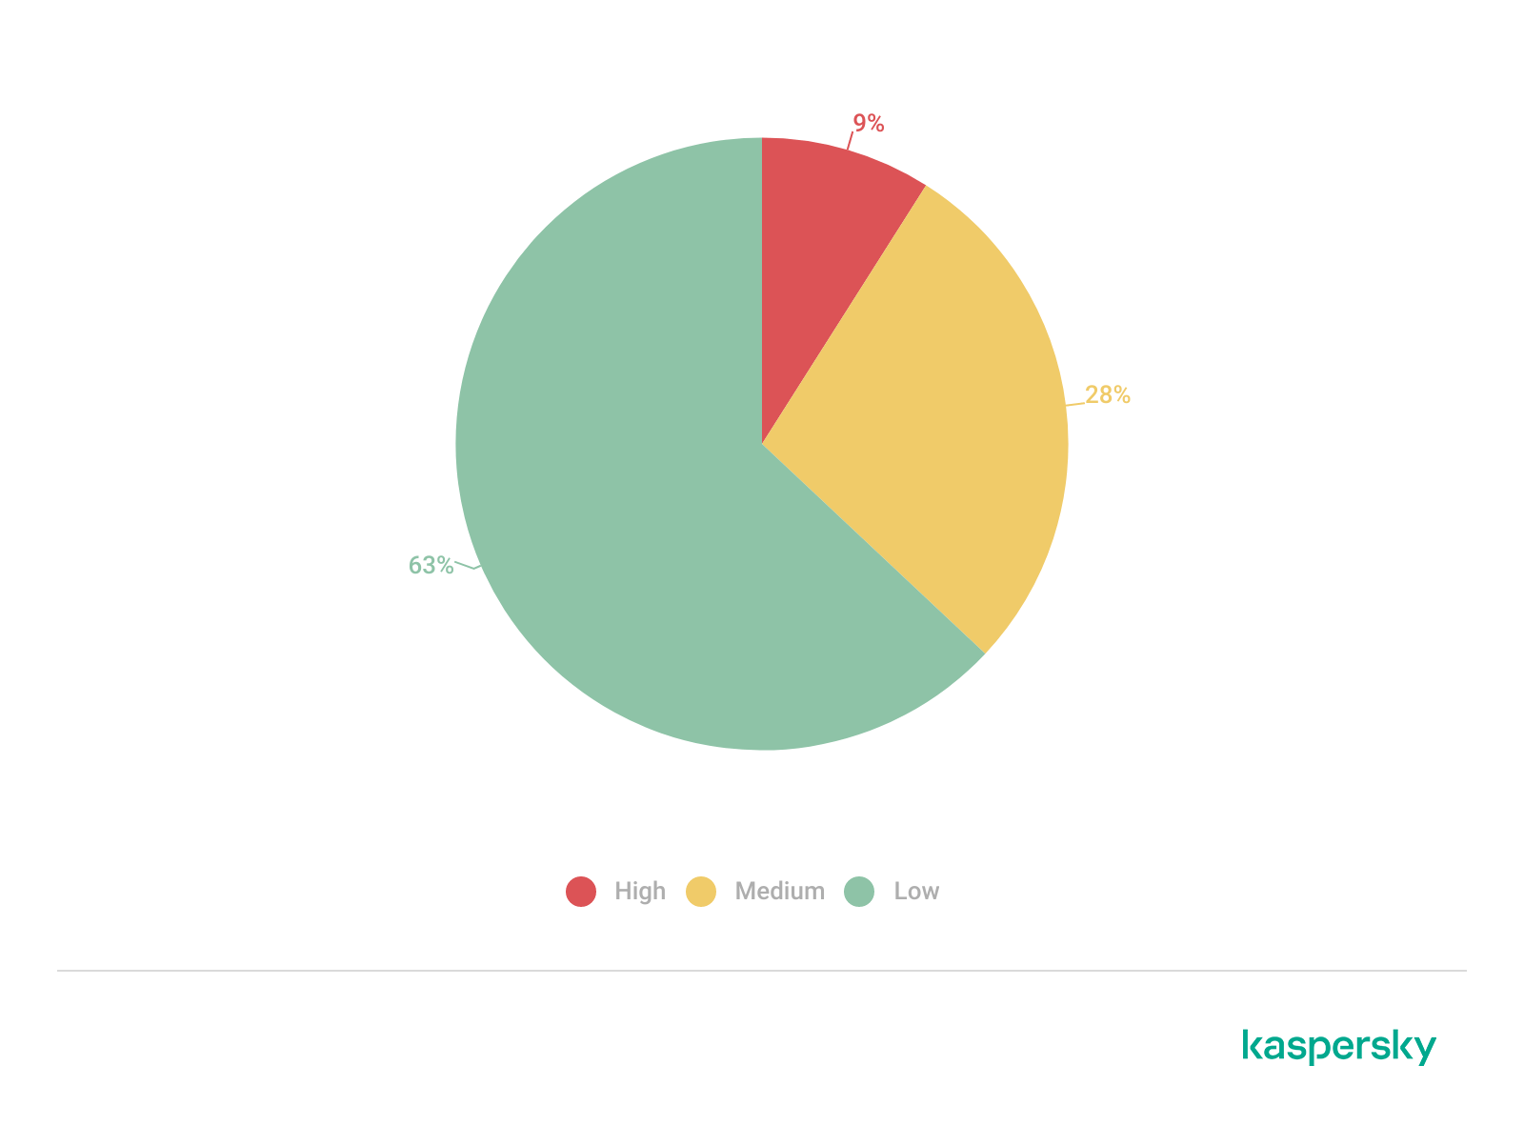
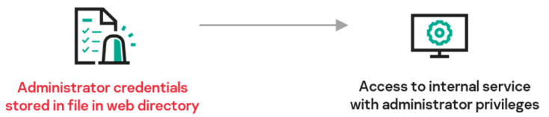
Sensitive Data Exposure
Among the sensitive data we identified during our analysis were plaintext one-time passwords and credentials, full paths to web application publish directories and other internal information that could be used to understand the application architecture.
Mitigation: do not store files containing sensitive data, such as passwords or backups, in web application publish directories. Avoid disclosing sensitive data when accessing application functions, unless the function itself is used to access sensitive data.
Distribution of Sensitive Data Exposure vulnerabilities by risk level, 2021–2023

Slide 59
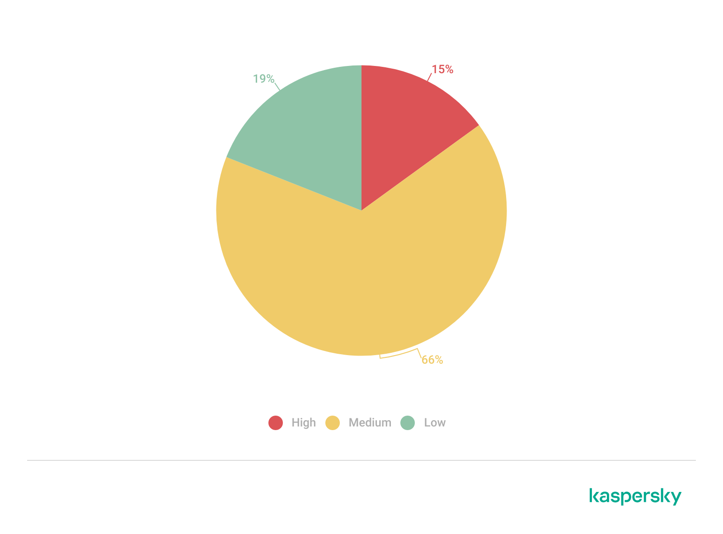
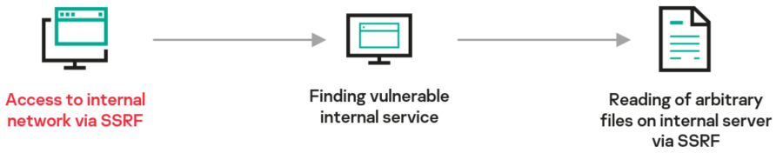
Server-Side Request Forgery (SSRF)
The popularity of the cloud and microservice architectures is on the rise. The microservice architecture expands the attack surface for SSRF exploitation due to more services communicating over HTTP (or other lightweight protocols) when compared to the traditional architecture.
Specifically, a malicious actor can use SSRF in a chain with other vulnerabilities to develop an attack on the web server or read the application source code.
Mitigation: if possible, create an allowlist of resources that the application can request. Prevent requests to any resources not on that list. Do not accept requests that contain complete URLs. Set firewall filters to prevent access to unauthorized domains.
Distribution of SSRF vulnerabilities by risk level, 2021–2023

Slide 60
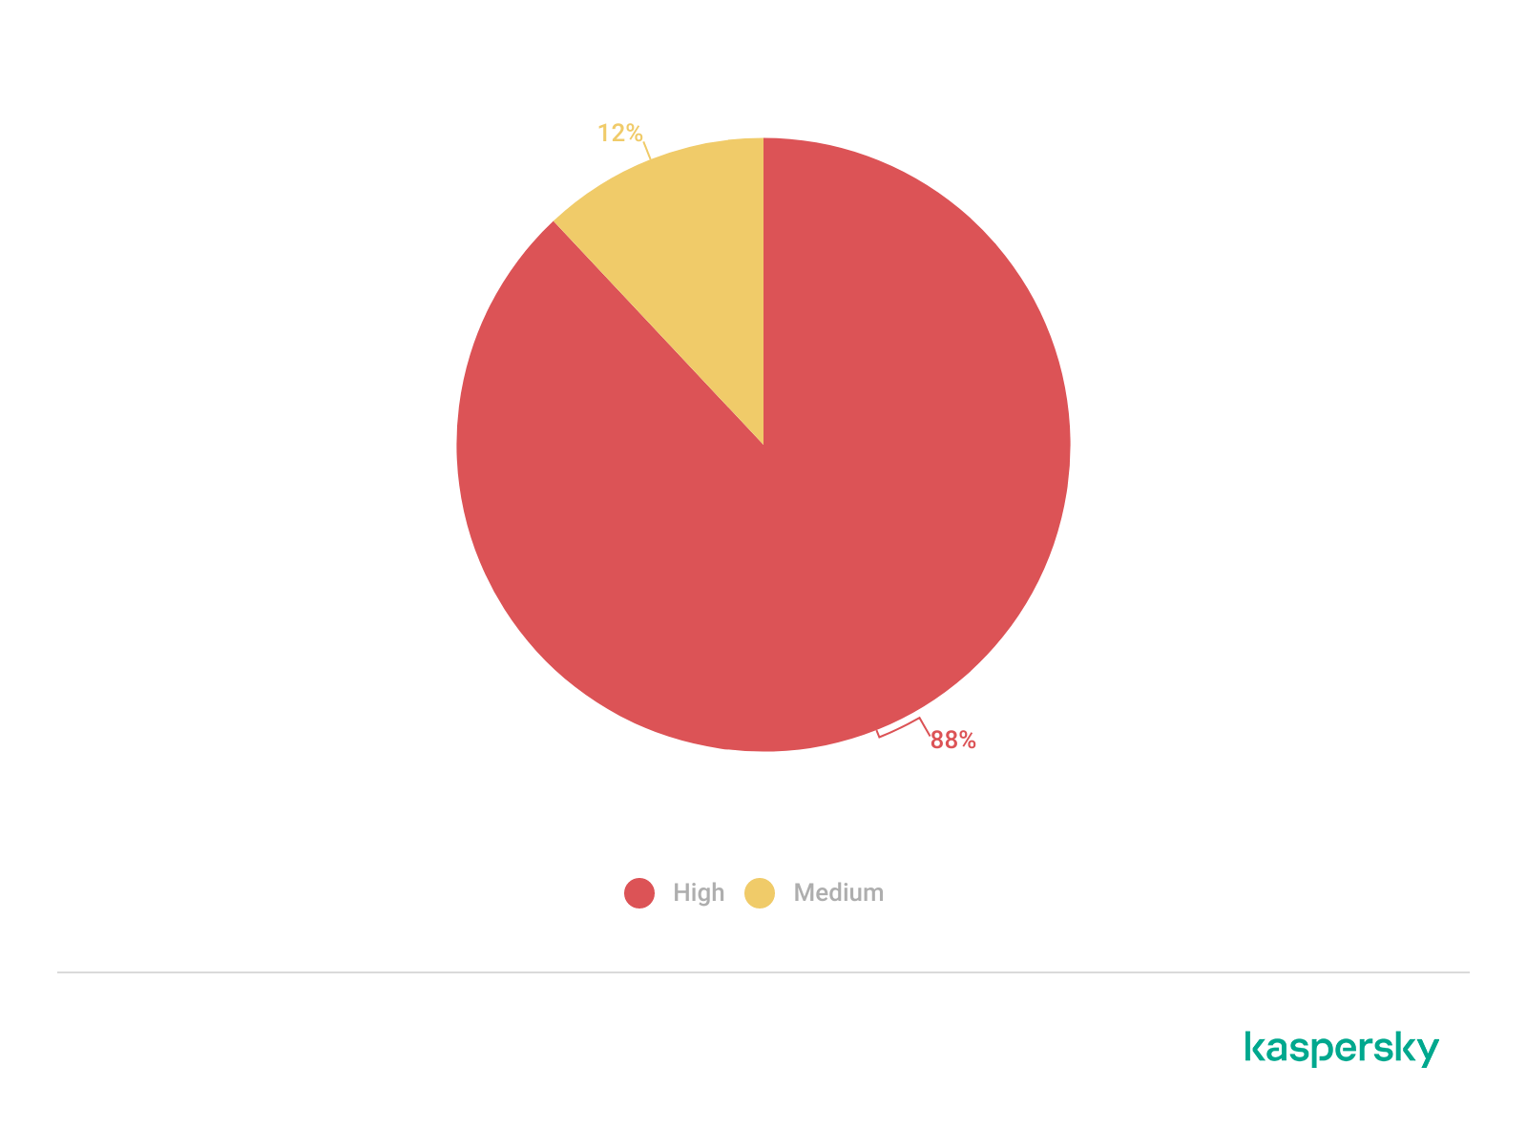
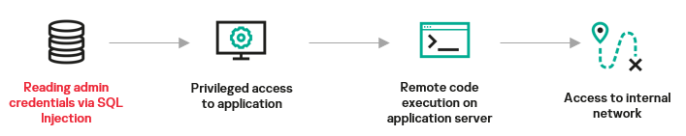
SQL Injection
Most high-risk vulnerabilities in 2021–2023
During one of the projects, an SQL injection into an application that was open to signup by any internet user let us obtain the credentials of an internal system administrator.
Mitigation: use parameterized SQL queries in application source code instead of combining them with a SQL query template. If you cannot use parameterized SQL queries, make sure that no data entered by the user and used in generating SQL queries can be used to modify the query logic
Distribution of SQL Injection vulnerabilities by risk level, 2021–2023

Slide 61
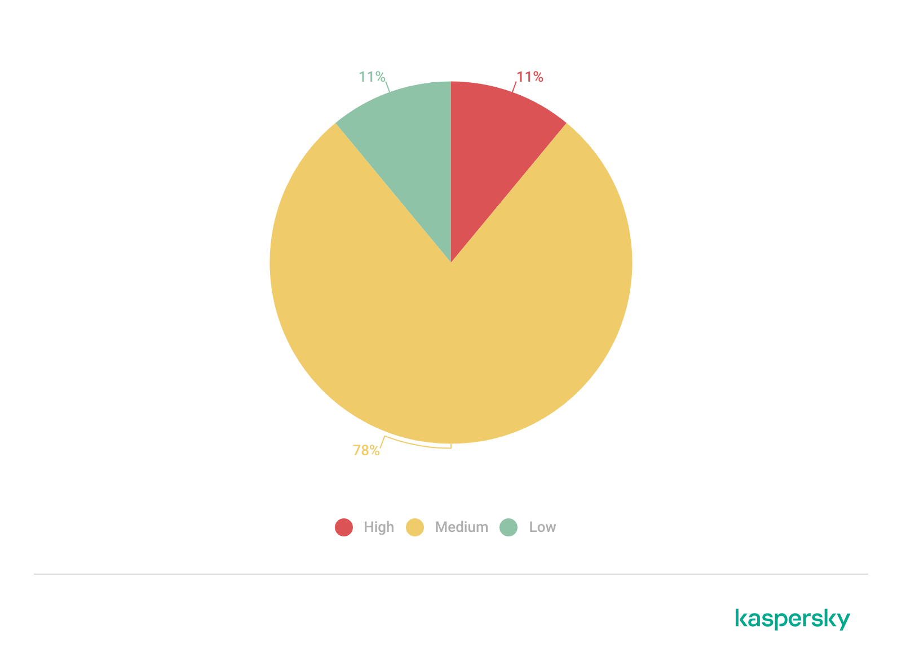
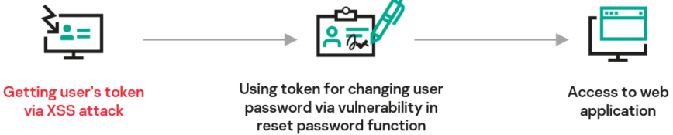
Cross-Site Scripting (XSS)
An XSS attack against the application’s clients can be used for obtaining user authentication information, such as cookies, phishing or spreading malware.
In one attack scenario, XSS in a chain with other vulnerabilities allowed changing a user password to a known value and so obtaining access to the application with that user’s privileges.
Mitigation: provide processing of web application user input by replacing potentially insecure characters that could be used to format HTML pages to their equivalents that are not format characters. This should be done for any data obtained from external sources and displayed in a browser (including HTTP headers, like User-Agent and Referer)
Distribution of XSS vulnerabilities by risk level, 2021–2023

Slide 62
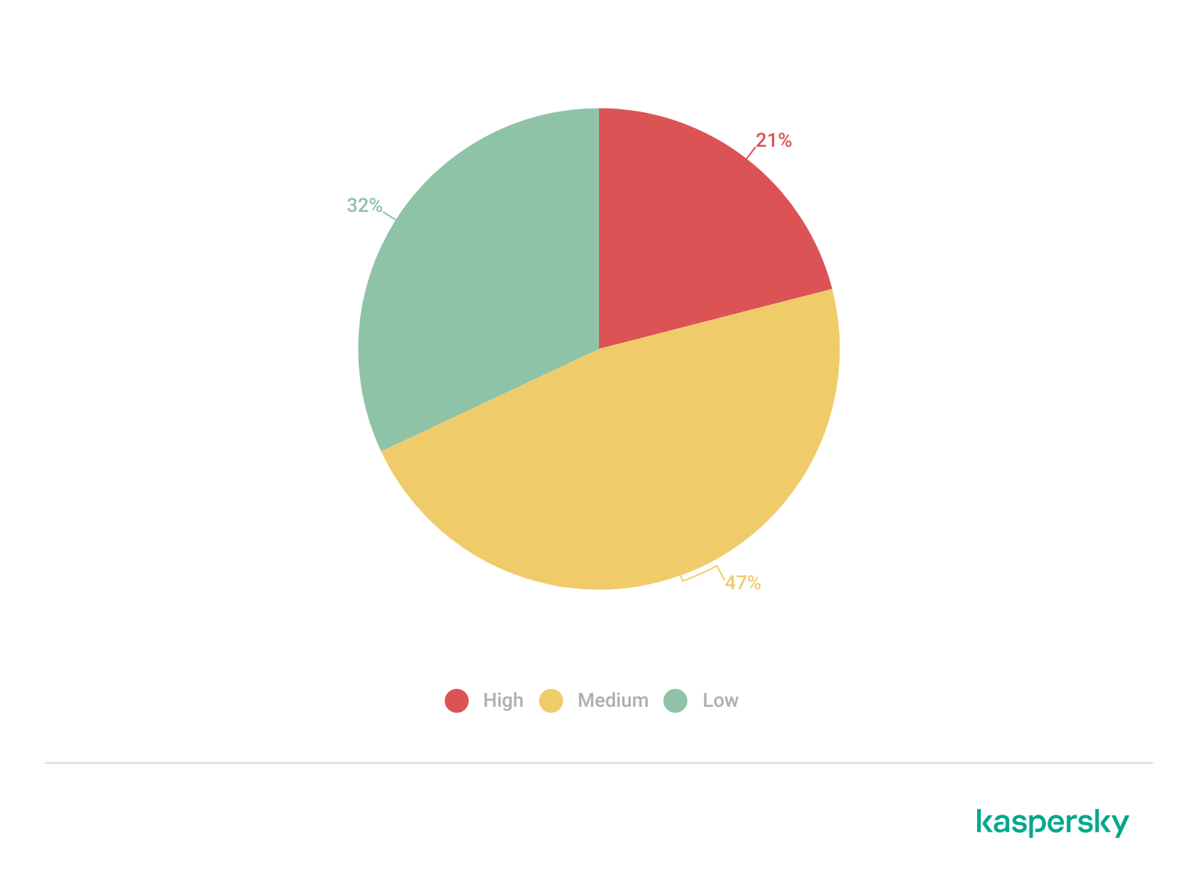
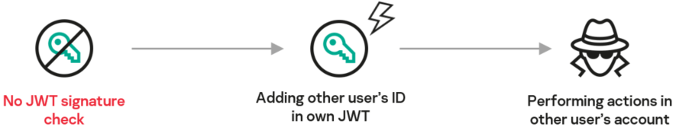
Broken Authentication
For example, a certain application had no JWT (Jason Web Token) signature check, so a malicious actor could modify their own JWT (by specifying another user’s ID) and use the resulting token to perform various actions inside the account.
Mitigation: implement proper validation of authentication data used for accessing the application. Verify token and session ID signatures when used. Secrets used for authentication (encryption keys, signatures and so on) should be unique and have a high degree of entropy. Do not store secrets in application code.
Distribution of Broken Authentication vulnerabilities by risk level, 2021–2023

Slide 63
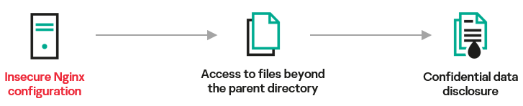
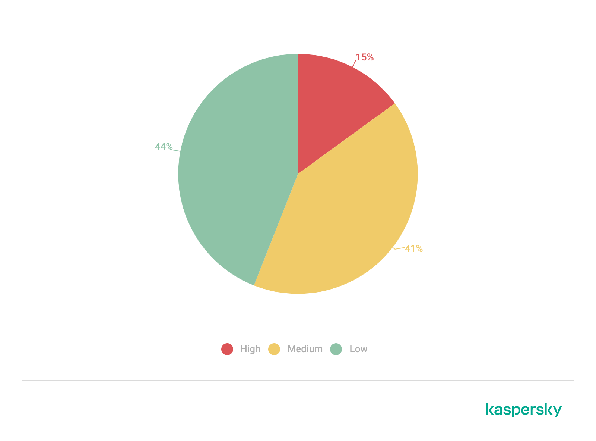
Security Misconfiguration
The Nginx server of one application we analyzed allowed access to files in a parent directory (relative to the directory specified in the Alias directive). This could be used for gaining access to files that contained confidential data.
Mitigation: follow security best practices when configuring systems used in your IT-infrastructure. Automate the setup process to eliminate errors when setting up new systems. Use different credentials for test and production systems. Disable unused components.
Distribution of Security Misconfiguration vulnerabilities by risk level, 2021–2023

Slide 64
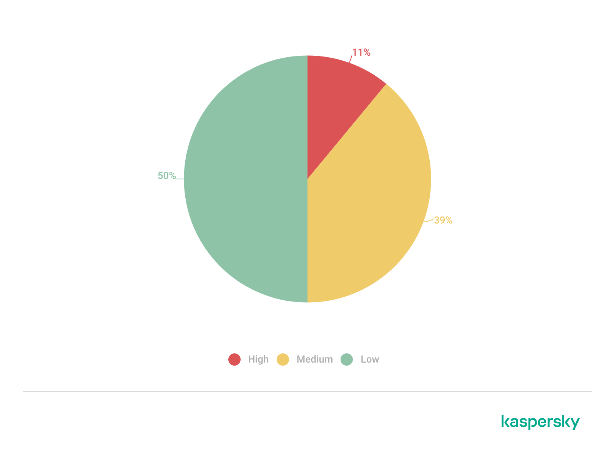
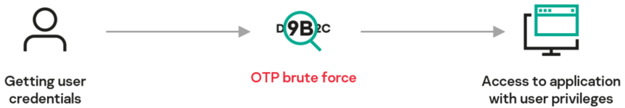
Insufficient Protection from Brute-Force Attacks
Specifically, a poor OTP implementation can allow an attacker to brute-force an OTP, bypassing this authentication factor and making unauthorized access to the application easier as a result.
Mitigation: use CAPTCHA to make it harder for the attacker to brute-force credentials. You can also use prevention controls (WAF, IPS) to promptly block brute-forcing attempts both in the case of multiple failed sign-ins to the same account and multiple failed sign-ins to different accounts that originate with the same source.

Slide 65
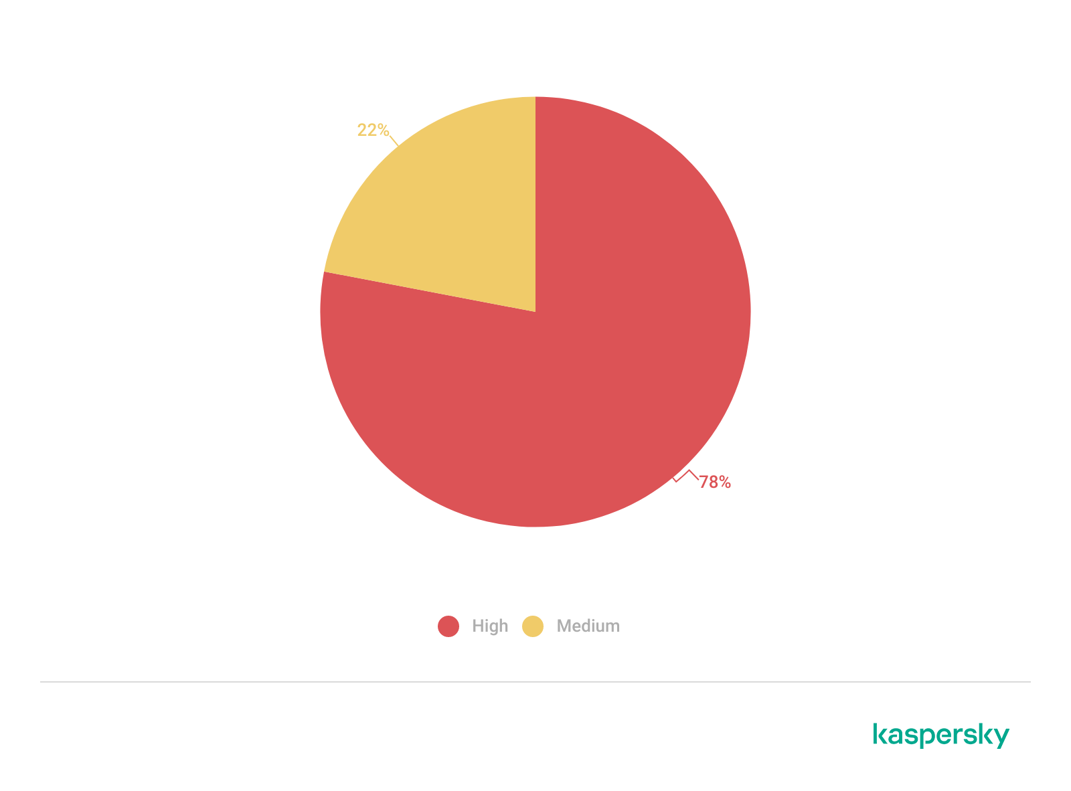
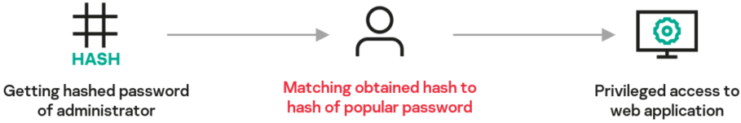
Weak User Password
Although the number of applications containing this type of vulnerabilities is small, the consequences of exploiting weak credentials can be significant. Depending on the account type, an attacker can get access to basic application features or administrative scenarios, which can impact business processes.
Mitigation: implement weak password checks, for example, by running new or changed passwords against a list of the 10,000 weakest passwords. Enforce password length, complexity and expiration requirements, along with other modern evidence-based password policies.
Distribution of Weak User Password vulnerabilities by risk level, 2021–2023

Slide 66
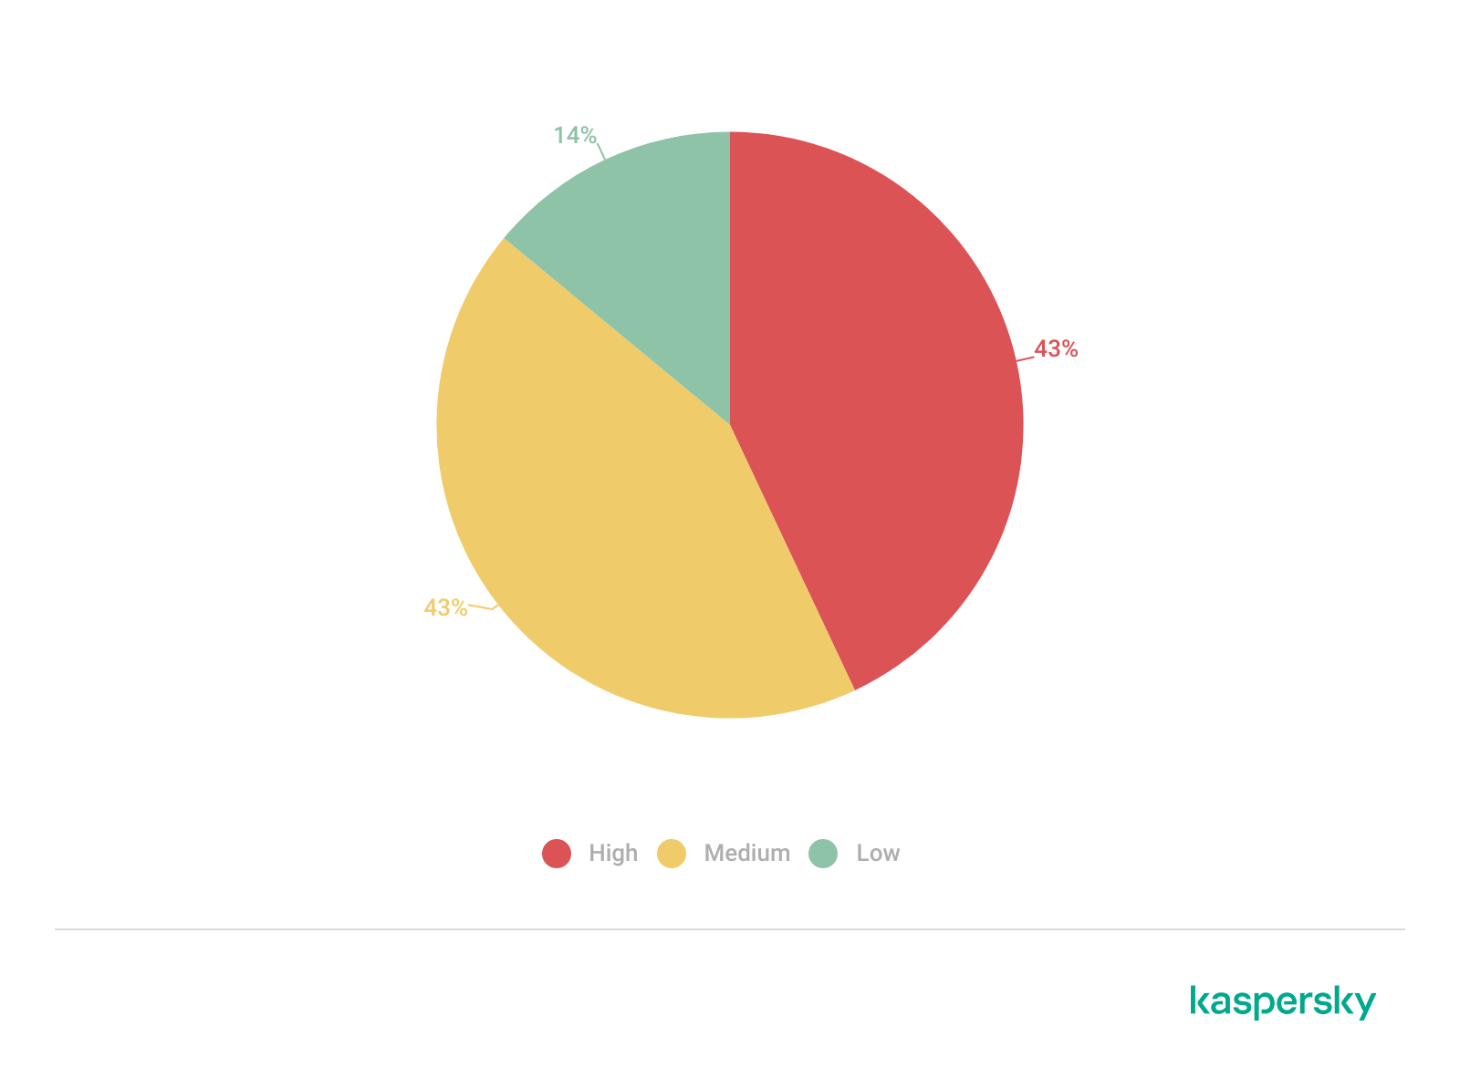
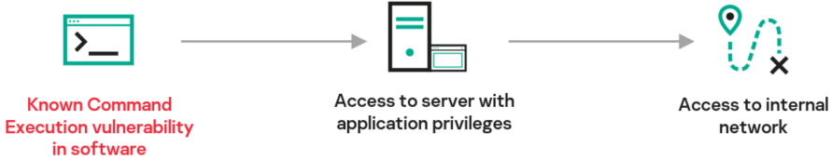
Using Components with Known Vulnerabilities
Among the vulnerable components were frameworks and various application dependencies, such as libraries and modules. Some of these allowed us to get access to servers used by the applications, and thus, penetrate the customers’ internal networks.
Mitigation: take regular inventories of software components you use, and update as required. Use only trusted components that have successfully passed security tests. Disable any unused components
Distribution of vulnerabilities caused by using components with known vulnerabilities by risk level, 2021–2023

Slide 67
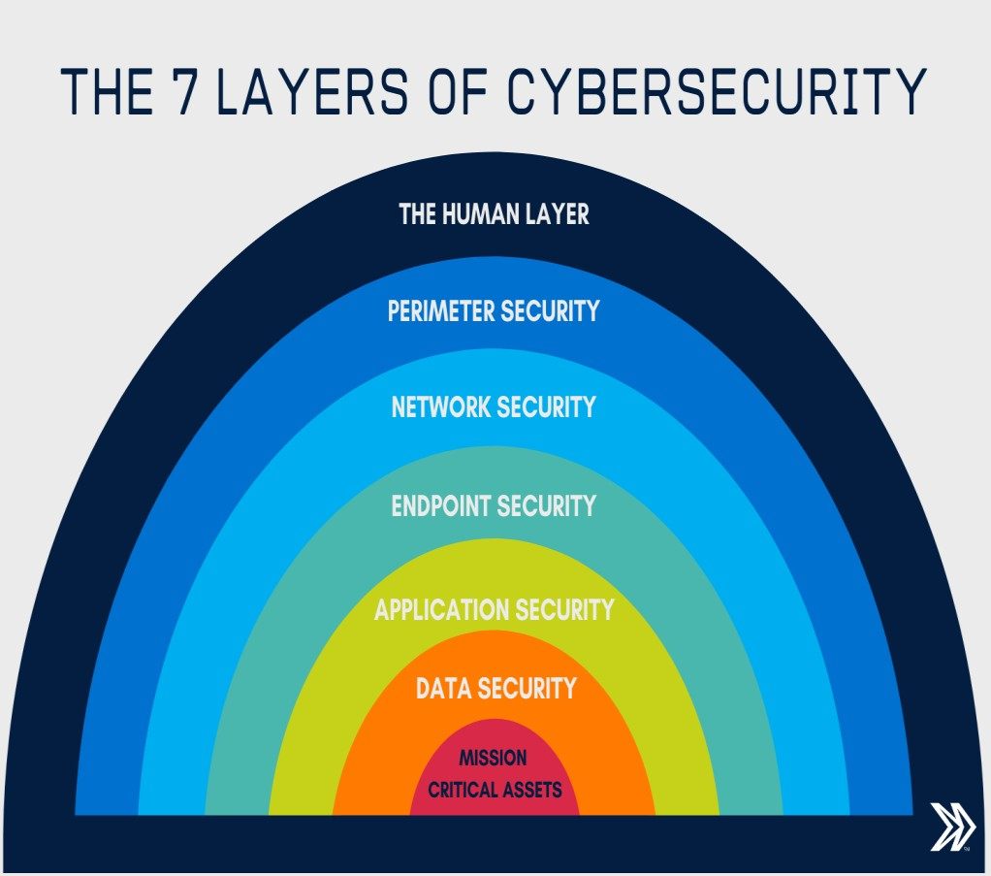

Slide 68
1: Mission Critical Assets – This is the data you need to protect
2: Data Security – Data security controls protect the storage and transfer of data.
3: Application Security – Applications security controls protect access to an application, an application’s access to your mission critical assets, and the internal security of the application.
4: Endpoint Security – Endpoint security controls protect the connection between devices and the network.

Slide 69
5: Network Security – Network security controls protect an organization’s network and prevent unauthorized access of the network.
6: Perimeter Security – Perimeter security controls include both the physical and digital security methodologies that protect the business overall.

Slide 70
7: The Human Layer – Humans are the weakest link in any cyber security posture. Human security controls include phishing simulations and access management controls that protect mission critical assets from a wide variety of human threats, including cyber criminals, malicious insiders, and negligent users.

Slide 71
Let’s discuss in reverse order…

Slide 72
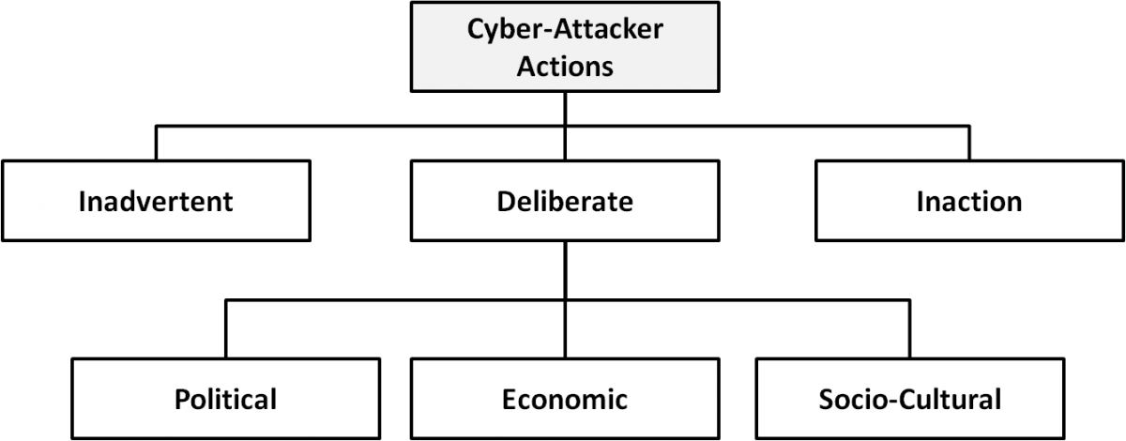

Slide 73
inadvertent actions (generally by insiders) that are taken without malicious or harmful intent;

Slide 74
deliberate actions (by insiders or outsiders) that are taken intentionally and are meant to do harm;

Slide 75
inaction (generally by insiders), such as a failure to act in a given situation, either because of a lack of appropriate skills, knowledge, guidance, or availability of the correct person to take action Of primary concern

Slide 76
Political motivations: examples include destroying, disrupting, or taking control of targets; espionage; and making political statements, protests, or retaliatory actions.
Economic motivations: examples include theft of intellectual property or other economically valuable assets (e.g., funds, credit card information); fraud; industrial espionage and sabotage; and blackmail.
Socio-cultural motivations: examples include attacks with philosophical, theological, political, and even humanitarian goals. Socio-cultural motivations also include fun, curiosity, and a desire for publicity or ego gratification.

Slide 77
Attacks

Slide 78
Injection attacks
It is the attack in which some data will be injected into a web application to manipulate the application and fetch the required information.
Example- SQL Injection, code Injection, log Injection, XML Injection etc.

Slide 79
DNS Spoofing
DNS Spoofing is a type of computer security hacking. Whereby a data is introduced into a DNS resolver's cache causing the name server to return an incorrect IP address, diverting traffic to the attackers computer or any other computer. The DNS spoofing attacks can go on for a long period of time without being detected and can cause serious security issues.

Slide 80
Session Hijacking
It is a security attack on a user session over a protected network. Web applications create cookies to store the state and user sessions. By stealing the cookies, an attacker can have access to all of the user data.

Slide 81
Phishing
Phishing is a type of attack which attempts to steal sensitive information like user login credentials and credit card number. It occurs when an attacker is masquerading as a trustworthy entity in electronic communication.

Slide 82
Brute force
It is a type of attack which uses a trial and error method. This attack generates a large number of guesses and validates them to obtain actual data like user password and personal identification number. This attack may be used by criminals to crack encrypted data, or by security, analysts to test an organization's network security.

Slide 83
Denial of Service
It is an attack which meant to make a server or network resource unavailable to the users. It accomplishes this by flooding the target with traffic or sending it information that triggers a crash. It uses the single system and single internet connection to attack a server.

Slide 84
Dictionary attacks
This type of attack stored the list of a commonly used password and validated them to get original password.

Slide 85
URL Interpretation
It is a type of attack where we can change the certain parts of a URL, and one can make a web server to deliver web pages for which he is not authorized to browse.

Slide 86
File Inclusion attacks
It is a type of attack that allows an attacker to access unauthorized or essential files which is available on the web server or to execute malicious files on the web server by making use of the include functionality.

Slide 87
Man in the middle attacks
It is a type of attack that allows an attacker to intercepts the connection between client and server and acts as a bridge between them. Due to this, an attacker will be able to read, insert and modify the data in the intercepted connection.

Slide 88
Virus
It is a type of malicious software program that spread throughout the computer files without the knowledge of a user. It is a self-replicating malicious computer program that replicates by inserting copies of itself into other computer programs when executed. It can also execute instructions that cause harm to the system.

Slide 89
Worm
It is a type of malware whose primary function is to replicate itself to spread to uninfected computers. It works same as the computer virus. Worms often originate from email attachments that appear to be from trusted senders.

Slide 90
Trojan horse
It is a malicious program that occurs unexpected changes to computer setting and unusual activity, even when the computer should be idle. It misleads the user of its true intent. It appears to be a normal application but when opened/executed some malicious code will run in the background.

Slide 91
Backdoors
It is a method that bypasses the normal authentication process. A developer may create a backdoor so that an application or operating system can be accessed for troubleshooting or other purposes.

Slide 92
Bots
A bot (short for "robot") is an automated process that interacts with other network services. Some bots program run automatically, while others only execute commands when they receive specific input. Common examples of bots program are the crawler, chatroom bots, and malicious bots.

Slide 93
Session replay: In this type of attack, a hacker steals an authorized user’s log in information by stealing the session ID. The intruder gains access and the ability to do anything the authorized user can do on the website.

Slide 94
Message modification: In this attack, an intruder alters packet header addresses to direct a message to a different destination or modify the data on a target machine.

Slide 95
In a distributed denial-of-service (DDoS) exploit, large numbers of compromised systems (sometimes called a botnet or zombie army) attack a single target.

Slide 96
Eavesdropping (tapping): the attacker simply listens to messages exchanged by two entities. For the attack to be useful, the traffic must not be encrypted. Any unencrypted information, such as a password sent in response to an HTTP request, may be retrieved by the attacker.

Slide 97
Traffic analysis: the attacker looks at the metadata transmitted in traffic in order to deduce information relating to the exchange and the participating entities, e.g. the form of the exchanged traffic (rate, duration, etc.). In the cases where encrypted data are used, traffic analysis can also lead to attacks by cryptanalysis, whereby the attacker may obtain information or succeed in unencrypting the traffic.

Slide 98
Software Attacks: Malicious code (sometimes called malware) is a type of software designed to take over or damage a computer user's operating system, without the user's knowledge or approval. It can be very difficult to remove and very damaging.

Slide 99
Need of Security policies-
It increases efficiency.
It upholds discipline and accountability
It can make or break a business deal
It helps to educate employees on security literacy

Slide 100
Virus and Spyware Protection policy:
It helps to detect threads in files, to detect applications that exhibits suspicious behavior.
Removes, and repairs the side effects of viruses and security risks by using signatures.

Slide 101
Firewall Policy:
It blocks the unauthorized users from accessing the systems and networks that connect to the Internet.
It detects the attacks by cybercriminals and removes the unwanted sources of network traffic.

Slide 102
Intrusion Prevention policy:
This policy automatically detects and blocks the network attacks and browser attacks.
It also protects applications from vulnerabilities and checks the contents of one or more data packages and detects malware which is coming through legal ways.

Slide 103
Application and Device Control:
This policy protects a system's resources from applications and manages the peripheral devices that can attach to a system.
The device control policy applies to both Windows and Mac computers whereas application control policy can be applied only to Windows clients.

Slide 104
References
PDPU Syllabus
NPTEL
MIT
Any other relevant material

Slide 105
N | Sort1
 | Best case |  |  | Average Case |  |  | Worst Case
 | COMP | EXCH | TIME | COMP | EXCH | TIME | COMP | EXCH | TIME
10 | # | # | #
100
1000
10000
100000

